Slide 1
Project Management Methodologies

Slide 2
Knowledge areas
Integration Management
Scope Management
Time Management
Cost Management
Quality Management

Slide 3
Knowledge areas
Human Resources Management
Communications Management
Risk Management
Procurement Management
Stakeholder Management

Slide 4
Management process groups
Initiating
Planning
Executing
Monitoring & Controlling
Closing

Slide 5
Management process groups
Project management is an integrative endeavor
Decisions and actions taken in one knowledge area at a certain time usually affect other knowledge areas

Slide 6
Management process groups
Managing these interactions
often requires making trade-offs among the project’s scope, time, and cost

Slide 7
Management process groups
You can view project management as a number of related processes
A process is a series of actions directed toward a particular result

Slide 8
Management process groups
Project management
process groups progress from initiating activities to planning activities, executing activities, monitoring and controlling activities, and closing activities

Slide 9
Management process groups
One project might have concept, development, implementation, and close-out phases,
and another might have
initial, intermediate, and final phases.

Slide 10
Management process groups
Initiating processes
Initiating processes take place during each phase of a project

Slide 11
Management process groups
Planning processes
devising and maintaining a workable scheme to
ensure that the project addresses the organization’s needs

Slide 12
Management process groups
Planning processes
Includes several plans, such as the scope management plan, schedule management plan, cost management plan, and procurement management plan

Slide 13
Management process groups
Planning processes
a project team must develop a plan to define
the work needed for the project, to schedule activities related to that work

Slide 14
Management process groups
Planning processes
a project team must estimate costs for performing the work, and to decide what resources to procure to accomplish the work.

Slide 15
Management process groups
Planning processes
a project team must account for changing conditions on the project and in the organization, project teams often revise plans during each phase of the project life cycle.

Slide 16
Management process groups
Executing processes
coordinating people and other resources to carry out the various plans and create the products, services, or results of the project or phase

Slide 17
Management process groups
Executing processes
acquiring and developing the project team, performing quality assurance, distributing information

Slide 18
Management process groups
Executing processes
managing stakeholder expectations, and conducting procurements

Slide 19
Management process groups
Monitoring and controlling processes
regularly measuring and monitoring progress to ensure that the project team meets the project objectives.

Slide 20
Management process groups
Monitoring and controlling processes
The project manager and staff monitor and measure progress against the plans and take corrective action when necessary.

Slide 21
Management process groups
Closing processes
formalizing acceptance of the project or project
phase and ending it efficiently

Slide 22
Management process groups
Closing processes
archiving project files, closing out contracts, documenting lessons learned, and receiving formal acceptance of the delivered work as part of the phase or project

Slide 23
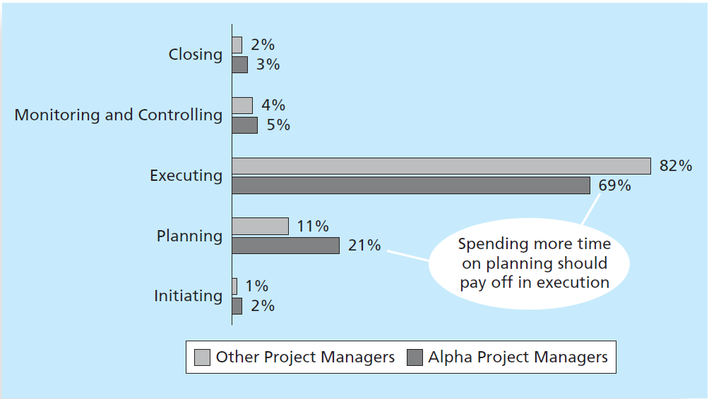
Management process groups

